Slide 1


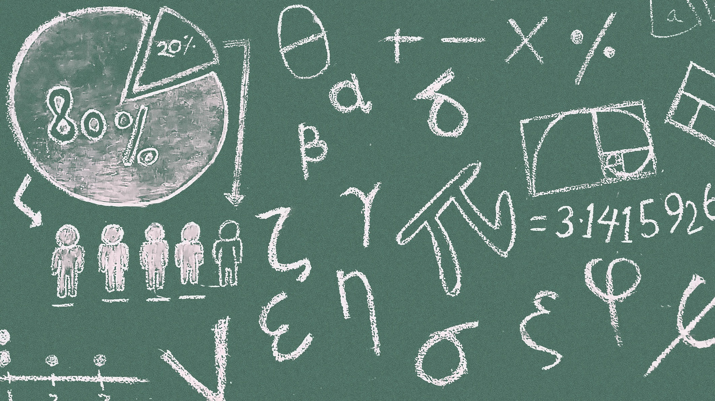

Varendra
University
Logical
Proposition
NAME : Pritom kumar
ID : 251311023
SEMESTER : 2nd
SECTION : A
BATCH : 36
DEPARTMENT OF CSE

Slide 2

Overview
Definition of Proposition
Conditional Proposition
Biconditional Proposition
Types of Propositions
Applications & Importance

Slide 3



Examples:
"2 + 2 = 4" → True
"The Earth is flat" → False
What is a proposition?
A declarative statement that is either true or false, but not both.
Non-examples:
Questions: "What time is it?"
Commands: "Close the door!”
Importance in Discrete Math:
The Basis of Logic.

Slide 4



Conditional Proposition
01
02
03
Definition:
Truth Table:
Example:
A compound proposition expressed as "If p, then q" (p → q) is used to convey a logical relationship where the occurrence of p guarantees the occurrence of q.
p | q | p → q
T | T | T
T | F | F
F | T | T
If it rains (p), then the ground gets wet (q).
It rains, but the ground does not get wet.
It doesn’t rain, but the ground is wet.

Slide 5

Biconditional Proposition
Definition:
A compound proposition of the form "p if and only if q" (p ↔ q).
True when p and q have the same truth value.
Truth Table:
Show p, q, and p ↔ q.
Example:
"A number is even if and only if it is divisible by 2."

Slide 6




Applications & Importance
Logical propositions are fundamental statements that are either true or false and form the basis of logical reasoning. They are widely used in computer science, mathematics, digital electronics, and AI for problem-solving, decision-making, and constructing algorithms or circuits.
Why we study propositions:
Foundation of logic, proofs, and algorithms.
Used in computer science (circuit design, programming conditions).
Useful in mathematical reasoning & problem solving.
Quick example in real life:
"If you pass the exam, then you graduate." (Conditional logic in rules).

Slide 7


